Slide 1

Institute of Molecular Biology
NAS, Armenia
Bioinformatics methods
in population genetics
Anahit Hovhannisyan

Slide 2
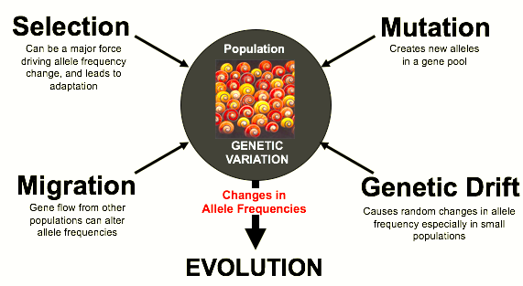
What is population genetics?

Slide 3

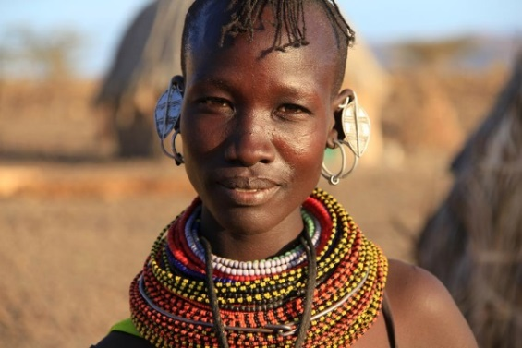
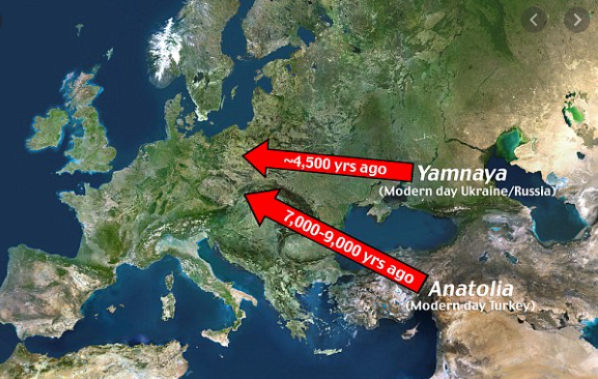
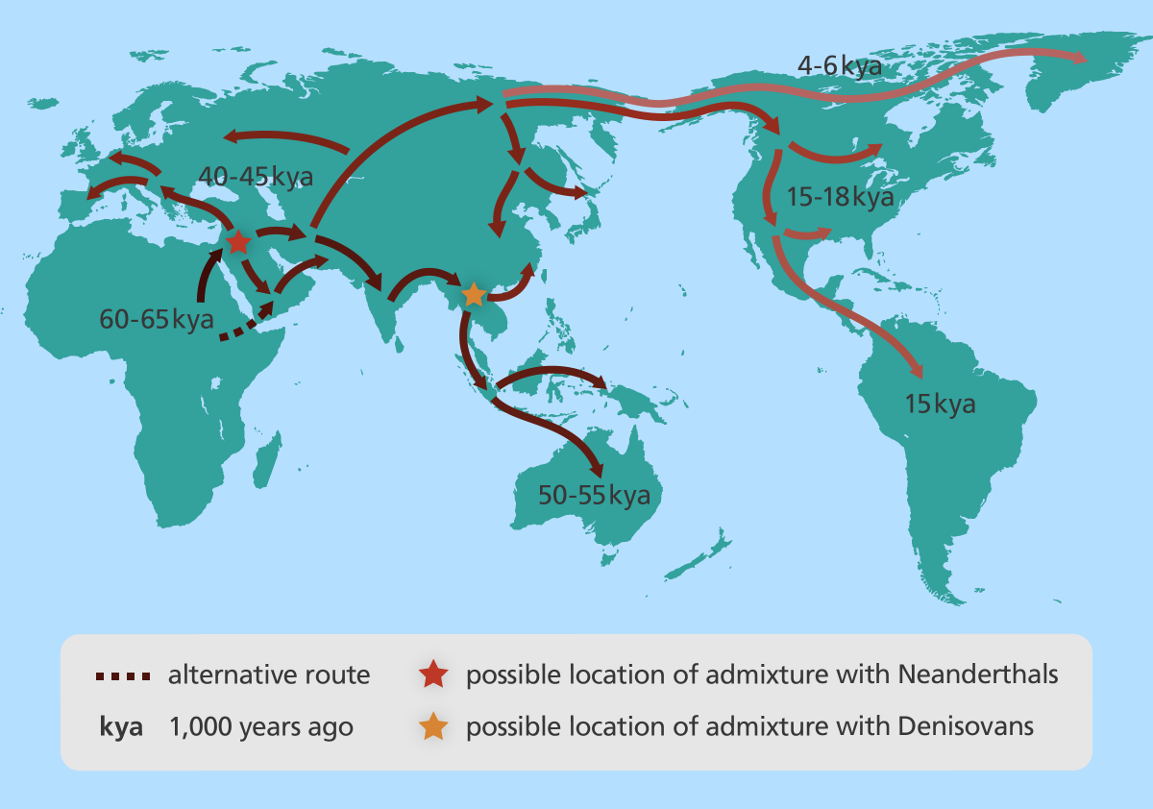
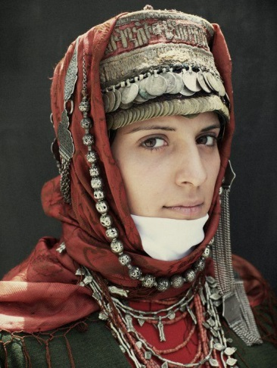
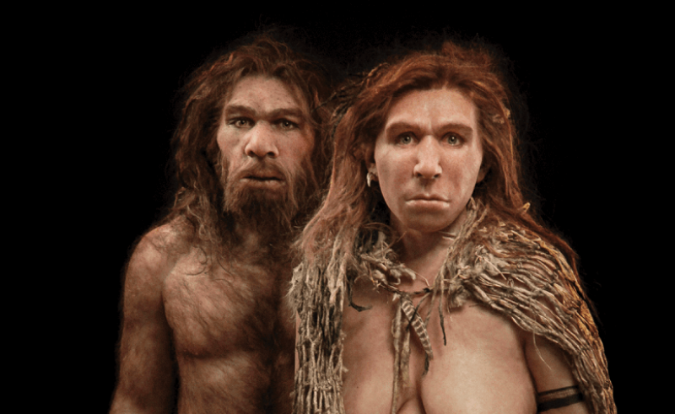
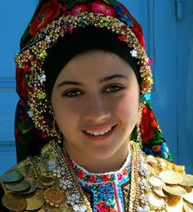
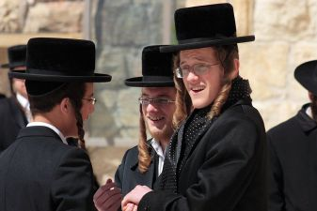
Population genetics

Slide 4
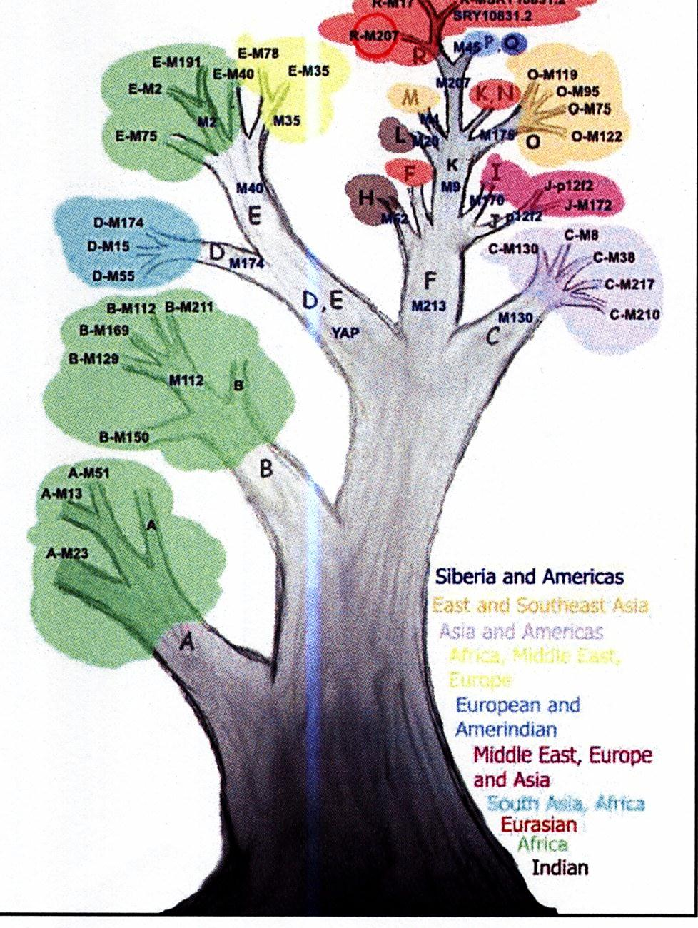
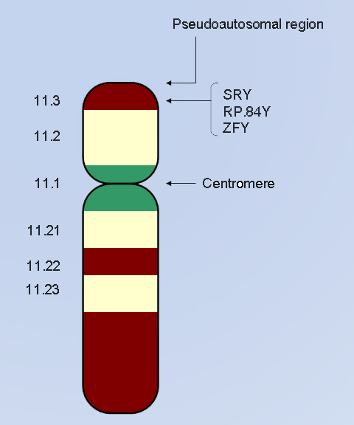
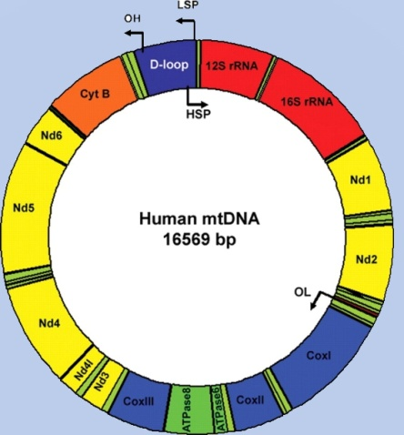
Genetic markers
Uniparental
Y chromosome
Bi-allelic markers
STRs (microsatellites)
mtDNA
SNPs on HV1, HV2
Evolutionary tree of Human Y-chromosome haplogroups

Slide 5
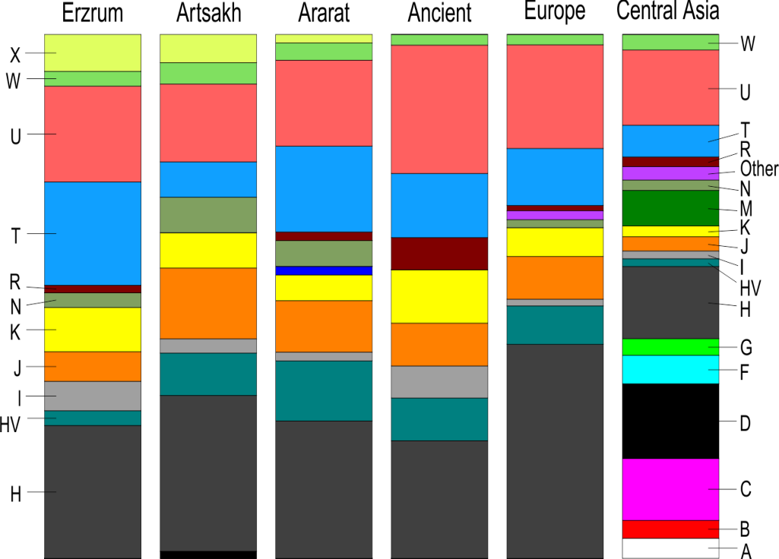
FOUNDING FATHERS OF ARMENIANS
Y chromosomal and mtDNA haplogroups
in Armenians
Y chromosomal haplogroups in a pooled population
mtDNA haplogroups in different modern and ancient population

Slide 6

Genetic markers
Uniparental
Biparental
Y chromosome
Autosomal STRs, few SNPs
Genome-wide autosomal SNP data
Whole genome sequence data
Bi-allelic markers
STRs (microsatellites)
mtDNA
SNPs on HV1, HV2

Slide 7
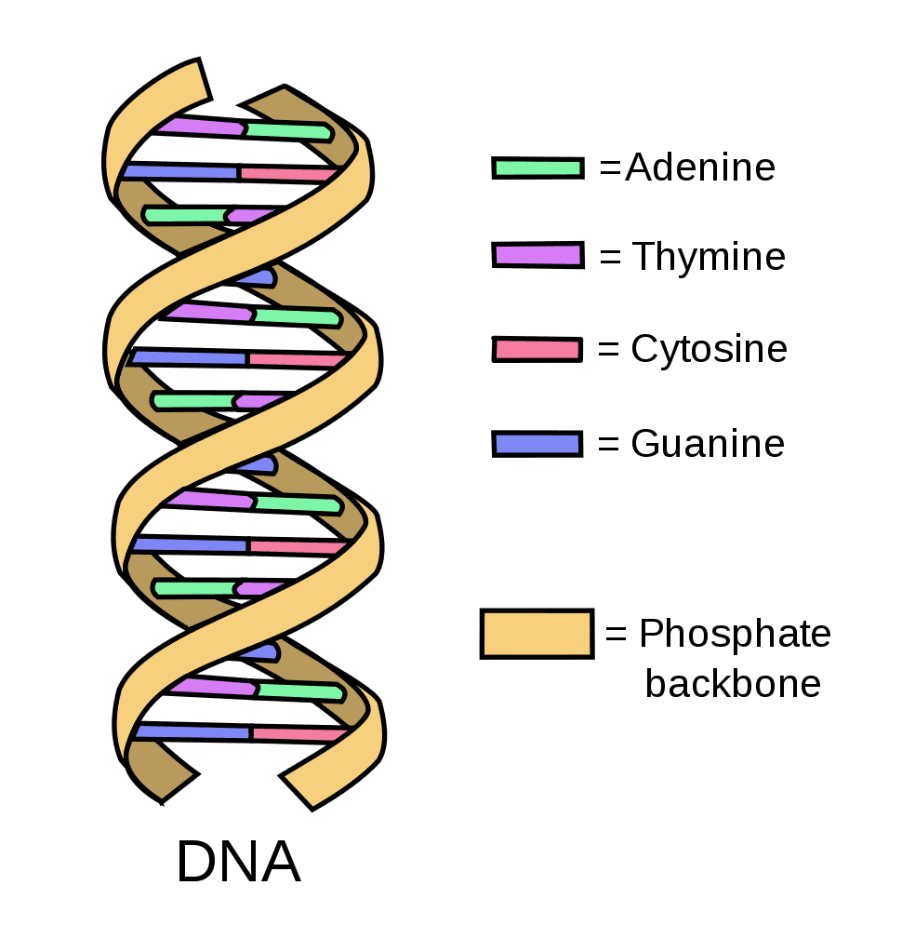
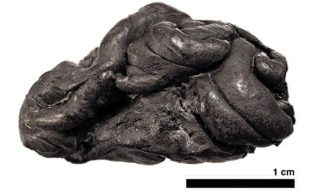
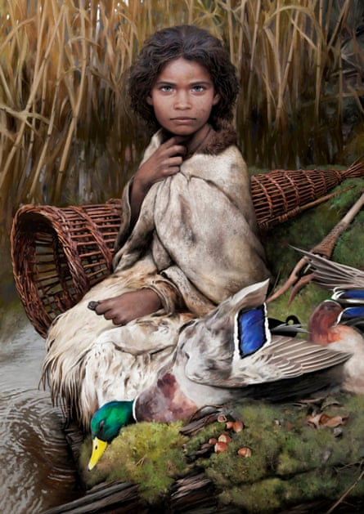
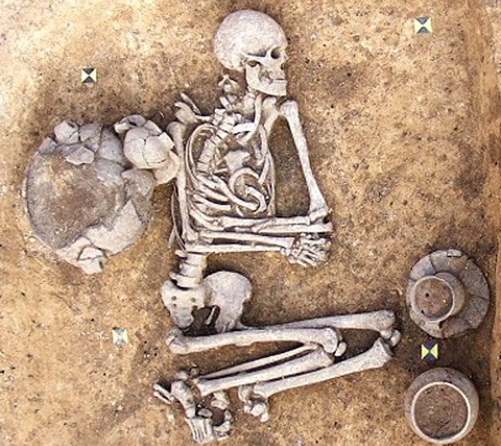
Ancient DNA

Slide 8
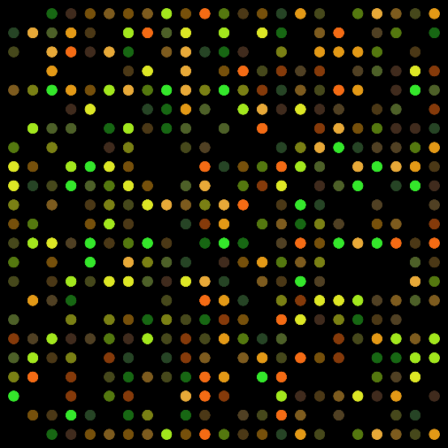


Data preparation
PLINK 1.09 - whole genome association analysis toolset
Merge two or more files
Quality control
- 97 % genotyping rate
- LD pruning (pairwise genotypic correlation r²=0.4)

Slide 9
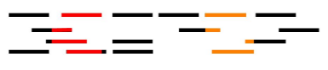
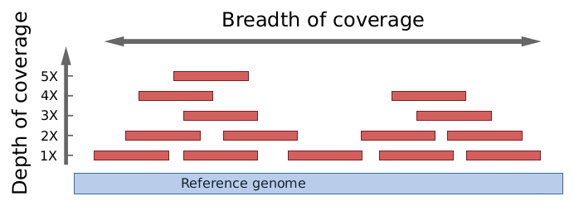
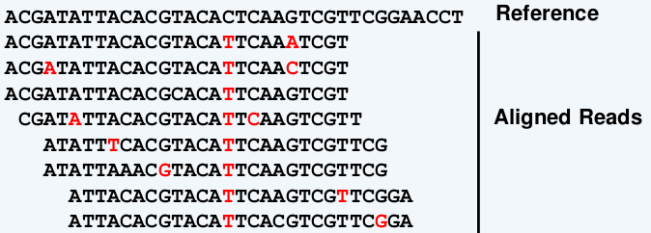
NGS workflow
Raw reads
FASTQ files
BWA-MEM, Picard, GATK
Mapping to human reference genome
Realign indels, remove duplicates
BAM files
GATK
Variant Calling and filtering
VCF files
Downstream analysis
T
Variant Call
T/T homozygote

Slide 10
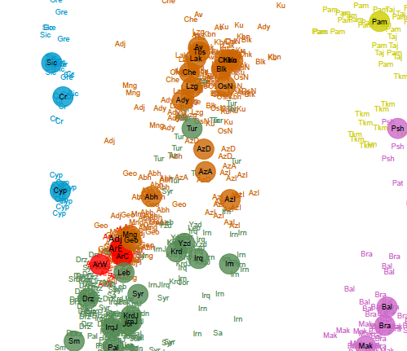
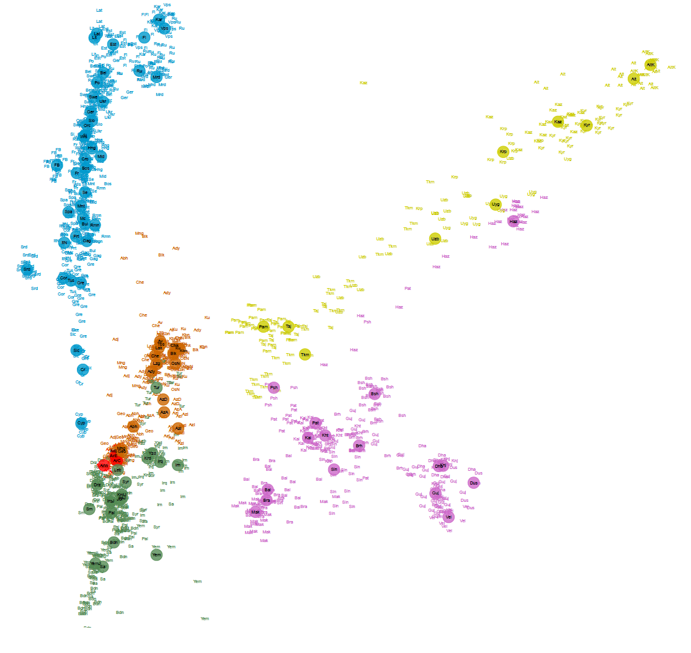
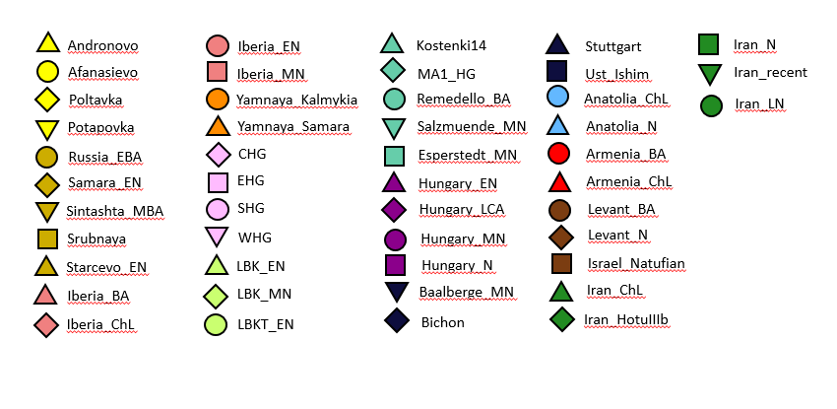
Visualizing and inferring population structure
Principal Component Analysis (EIGENSOFT software, smartpca)
PC1 (1.36)
PC1 (1.33)
Europe
Central Asia
PC2 (0.79)
North Caucasus
PC2(0.69)
aDNA projection
South Asia

Slide 11
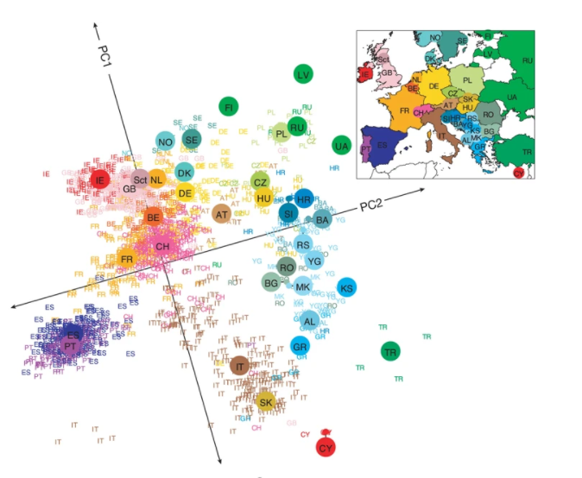
Principal Component Analysis (EIGENSOFT software, smartpca)
Novembre et al., 2008, Nature

Slide 12
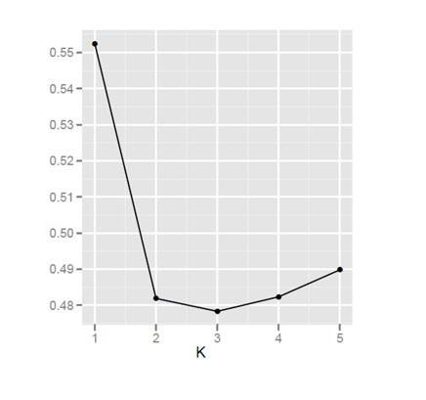
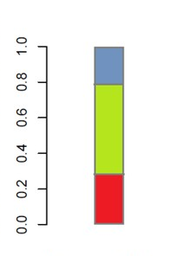
Visualizing and inferring population structure
ADMIXTURE analysis
N samples, M populations
Hypothesis - K=3 ancestral populations
ADMIXTURE software
ancestral population N1-20%,
ancestral population N2-60%,
ancestral population N3-20%
error
Imput of K ancestral
populations
Sample N 1

Slide 13
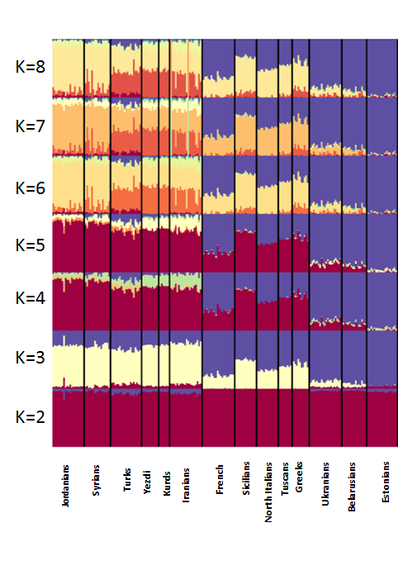
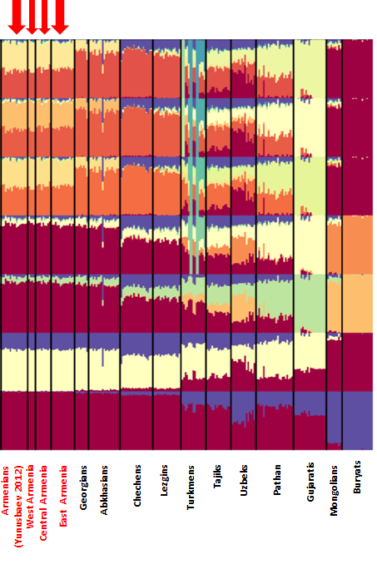
Visualizing and inferring population structure

Slide 14
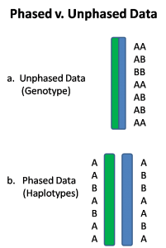
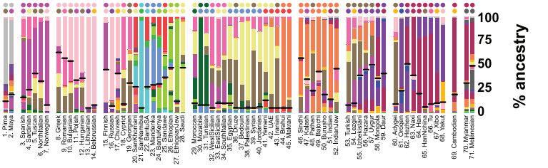
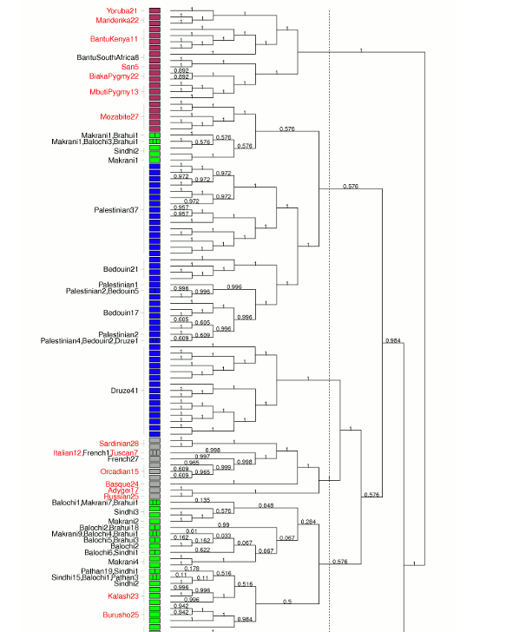
Haplotype-based analysis
Gentype data
Phasing (SHAPIT, BEAGLE 4.1)
Chromopainter
Haplotype data
fineSTRUCTURE

Slide 15
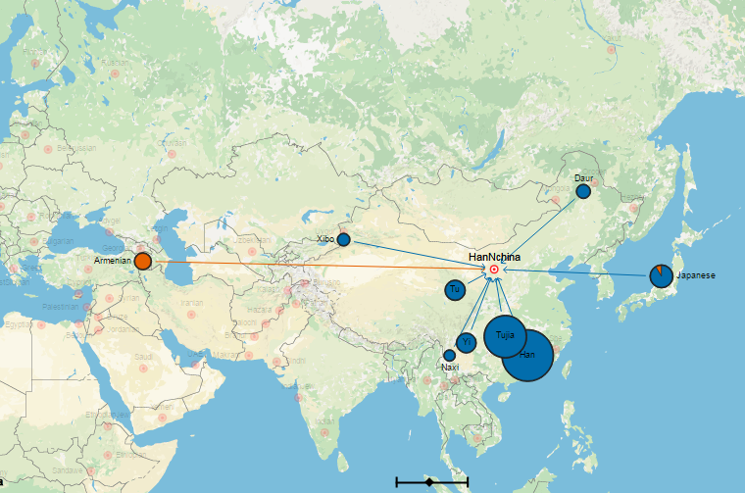
Haplotype-based analysis
4 % of Armenian genetic links to Han
Hellenthal et al., 2014, Science

Slide 16
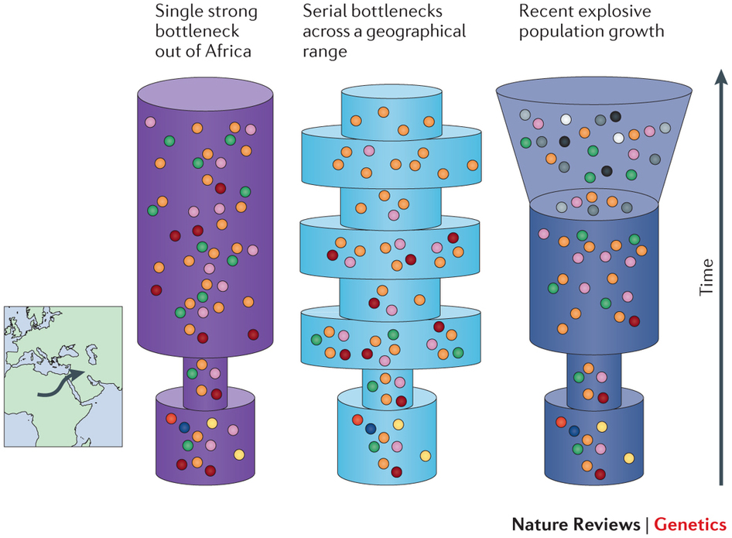
Simulation methods(BEAST, ABC)

Slide 17
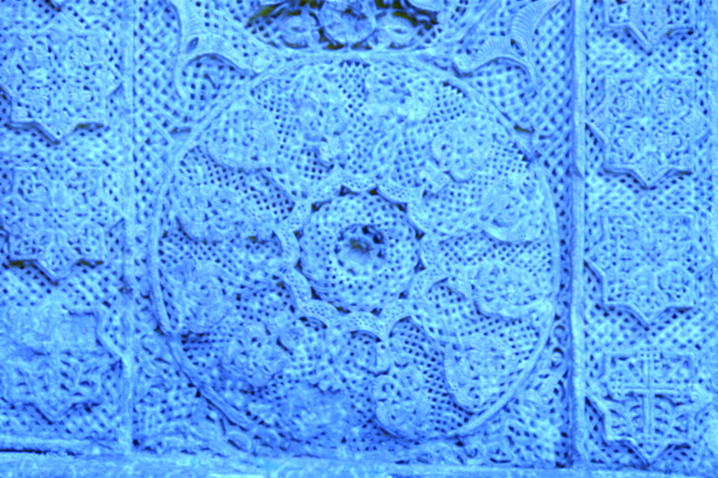
GENOMIC HISTORY OF ARMENIANS

Slide 18
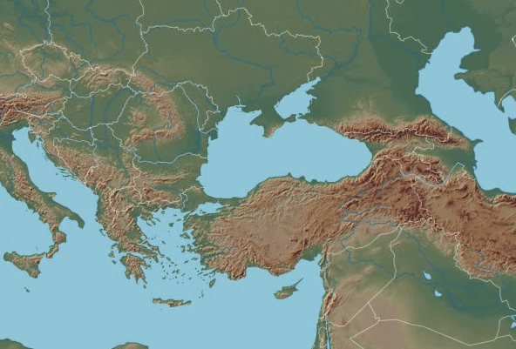
Geographical position of the Armenian Highland
Caucasus
Armenian
Highland
Anatolian
Plateau
Iranian
Plateau
Fertile Crescent

Slide 19
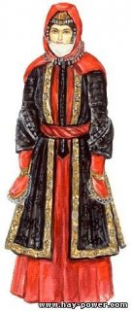
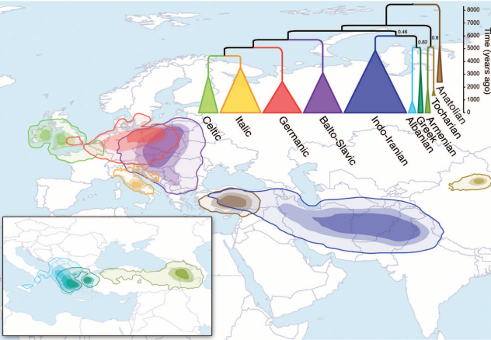
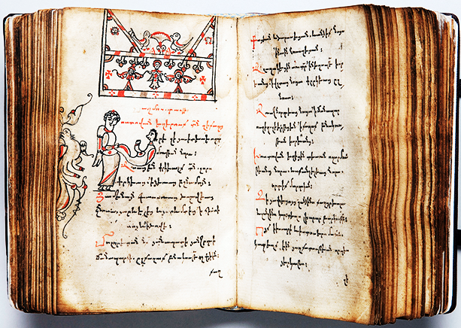
Strong ethnic and cultural identity of Armenians
Armenian language as a separate branch within the Indo-European linguistic family
Diversification of the major Indo-European subfamilies
(Bouckaert et al. 2012, Science)

Slide 20
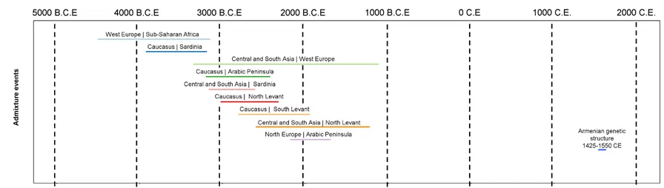
Long-term genetic isolation of the population
Time of mixture
Haber et al. 2015, EJHG

Slide 21
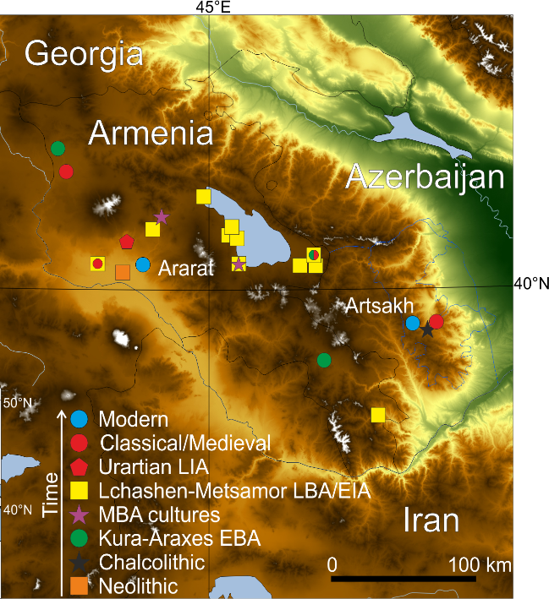
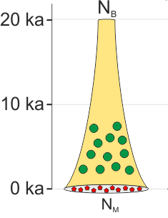
Eight millennia of matrilineal genetic continuity
Margaryan et al., 2017, Cur Biol

Slide 22
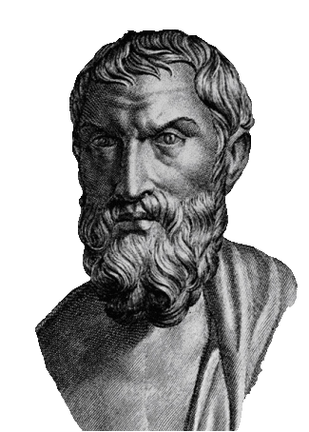
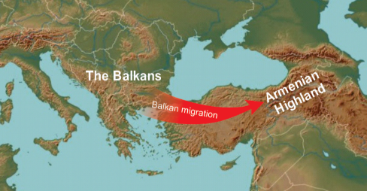
Balkan theory
“The Armenians were armed like the Phrygians,
being Phrygian settlers (refugees).”
Herodotus, History, 7.73

Slide 23
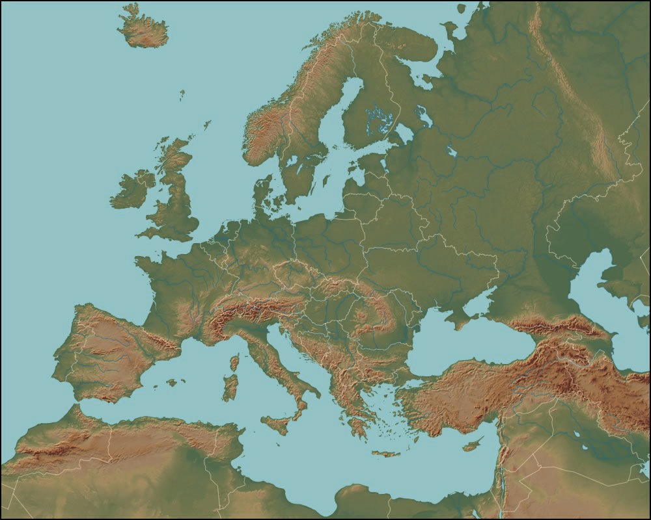
Materials
8 full genomes of Armenians, 4GP (this study, Mallick et al., 2016)
19 ancient samples from Armenia (Lazaridis et al., 2016; Damgaard et al., 2018)
19 ancient samples from the Balkans (Lazaridis et al., 2017)
EA
CA
Armenian
Highland
The Balkans
WA
WA, CA, EA – western, central and eastern Armenia, respectively.

Slide 24
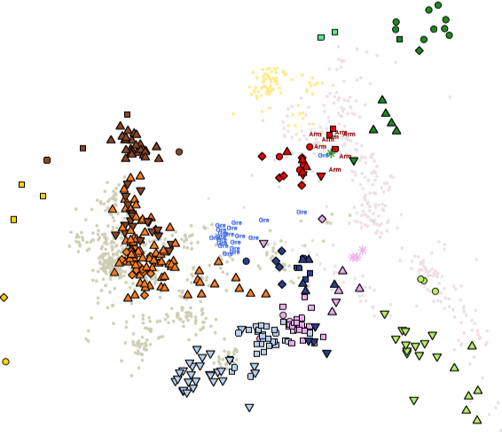
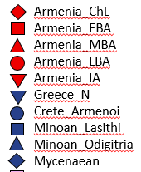
Testing the Balkan theory
PC2 (0.34%)
Armenian cluster
Balkan cluster
PC1 (0.85%)

Slide 25
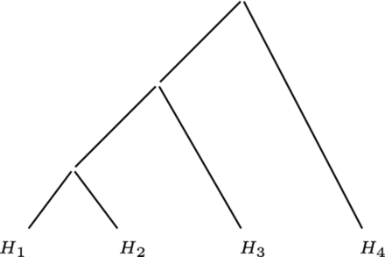
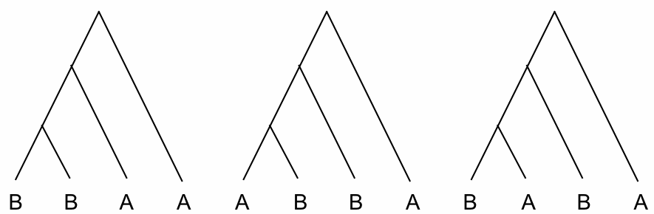
Testing the Balkan theory
D statistics
Z > 3
|Z|< 3
Z< 3
X
Y
Z
W
-allelic state

Slide 26
Testing the Balkan theory
D statistics
|Z|< 3
Modern
Armenia
X
Ancient
Armenia
Mbuti
Balkans
Armenian samples form a clade (|Z|< 3) to the exclusion of modern and ancient Balkan samples
Rejecting the Balkan theory

Slide 27
Testing the regional genetic continuity
D statistics
Modern
Armenia
X
Ancient
Armenia
Mbuti
Ancient samples

Slide 28
Testing the regional genetic continuity
A | B | X | Y | D | Z score | ABBA | BABA
Armenian | Armenia_ChL | Steppe_Eneolithic | Mbuti | -0.0209 | -8.772 | 35,612 | 37,131
Armenian | Armenia_EBA | Steppe_Eneolithic | Mbuti | -0.009 | -3.753 | 35,468 | 36,111
Armenian | Armenia_MBA | Steppe_Eneolithic | Mbuti | -0.0131 | -3.866 | 18,543 | 19,035
Armenian | Armenia_LBA | Steppe_Eneolithic | Mbuti | -0.0176 | -5.357 | 32,601 | 33,770
Armenian | Armenia_IA | Steppe_Eneolithic | Mbuti | -0.0139 | -4.692 | 33,309 | 34,248
Armenian | Armenia_ChL | Steppe_EMBA | Mbuti | -0.0124 | -7.503 | 51,333 | 52,625
Armenian | Armenia_EBA | Steppe_EMBA | Mbuti | -0.0093 | -5.284 | 50,256 | 51,198
Armenian | Armenia_MBA | Steppe_EMBA | Mbuti | -0.0128 | -6.211 | 26,483 | 27,170
Armenian | Armenia_LBA | Steppe_EMBA | Mbuti | -0.0154 | -6.617 | 45,544 | 46,968
Armenian | Armenia_IA | Steppe_EMBA | Mbuti | -0.013 | -6.141 | 50,087 | 51,408
Armenian | Armenia_ChL | Steppe_MLBA | Mbuti | -0.0117 | -7.31 | 51,356 | 52,570
Armenian | Armenia_EBA | Steppe_MLBA | Mbuti | -0.0064 | -3.642 | 50,361 | 51,009
Armenian | Armenia_MBA | Steppe_MLBA | Mbuti | -0.0078 | -3.839 | 26,607 | 27,027
Armenian | Armenia_LBA | Steppe_MLBA | Mbuti | -0.0104 | -4.757 | 45,731 | 46,688
Armenian | Armenia_IA | Steppe_MLBA | Mbuti | -0.0092 | -4.416 | 50,259 | 51,197

Slide 29
Testing the regional genetic continuity
D statistics
Z< 3
Modern
Armenia
X
Ancient
Armenia
Mbuti
Ancient samples
Modern Armenians stood out with a number of significantly high D values (Z< 3)
Genetic influx after the Bronze/Iron Age

Slide 30
Identifying the nature of the genetic influx
Modern
Armenia
X
Ancient
Armenia
Mbuti
Modern samples

Slide 31
Identifying the nature of the genetic influx
A | B | X | Y | D | Z score | ABBA | BABA
Armenian | Armenia_ChL | Sardinian | Mbuti | 0.0015 | 0.892 | 27,281 | 27,201
Armenian | Armenia_ChL | Sicilian | Mbuti | 0.0015 | 0.946 | 27,171 | 27,090
Armenian | Armenia_ChL | Italian_North | Mbuti | -0.0003 | -0.198 | 27,240 | 27,257
Armenian | Armenia_EBA | Sardinian | Mbuti | 0.0074 | 3.978 | 26,815 | 26,419
Armenian | Armenia_EBA | Sicilian | Mbuti | 0.0066 | 3.635 | 26,687 | 26,336
Armenian | Armenia_EBA | Italian_North | Mbuti | 0.0052 | 2.856 | 26,762 | 26,487
Armenian | Armenia_MBA | Sardinian | Mbuti | 0.004 | 1.719 | 24,511 | 24,315
Armenian | Armenia_MBA | Sicilian | Mbuti | 0.0032 | 1.397 | 24,392 | 24,238
Armenian | Armenia_MBA | Italian_North | Mbuti | 0.0022 | 0.966 | 24,470 | 24,365
Armenian | Armenia_LBA | Sardinian | Mbuti | 0.0106 | 4.698 | 14,626 | 14,319
Armenian | Armenia_LBA | Sicilian | Mbuti | 0.0089 | 4.094 | 14,547 | 14,289
Armenian | Armenia_LBA | Italian_North | Mbuti | 0.0069 | 3.133 | 14,579 | 14,380
Armenian | Armenia_IA | Sardinian | Mbuti | 0.0064 | 2.77 | 26,151 | 25,821
Armenian | Armenia_IA | Sicilian | Mbuti | 0.0054 | 2.43 | 26,024 | 25,744
Armenian | Armenia_IA | Italian_North | Mbuti | 0.0031 | 1.44 | 26,080 | 25,919

Slide 32
Identifying the nature of the genetic influx
Z > 3
Modern
Armenia
X
Ancient
Armenia
Mbuti
Modern samples
The clade is broken by introgression from a Sardinian-like source (Z>3)
Early farmers migration left genetic footprints in the region

Slide 33
Conclusion
Balkan theory on the origins of Armenians is rejected
Genetic continuity in the region is not constant across time

Slide 34
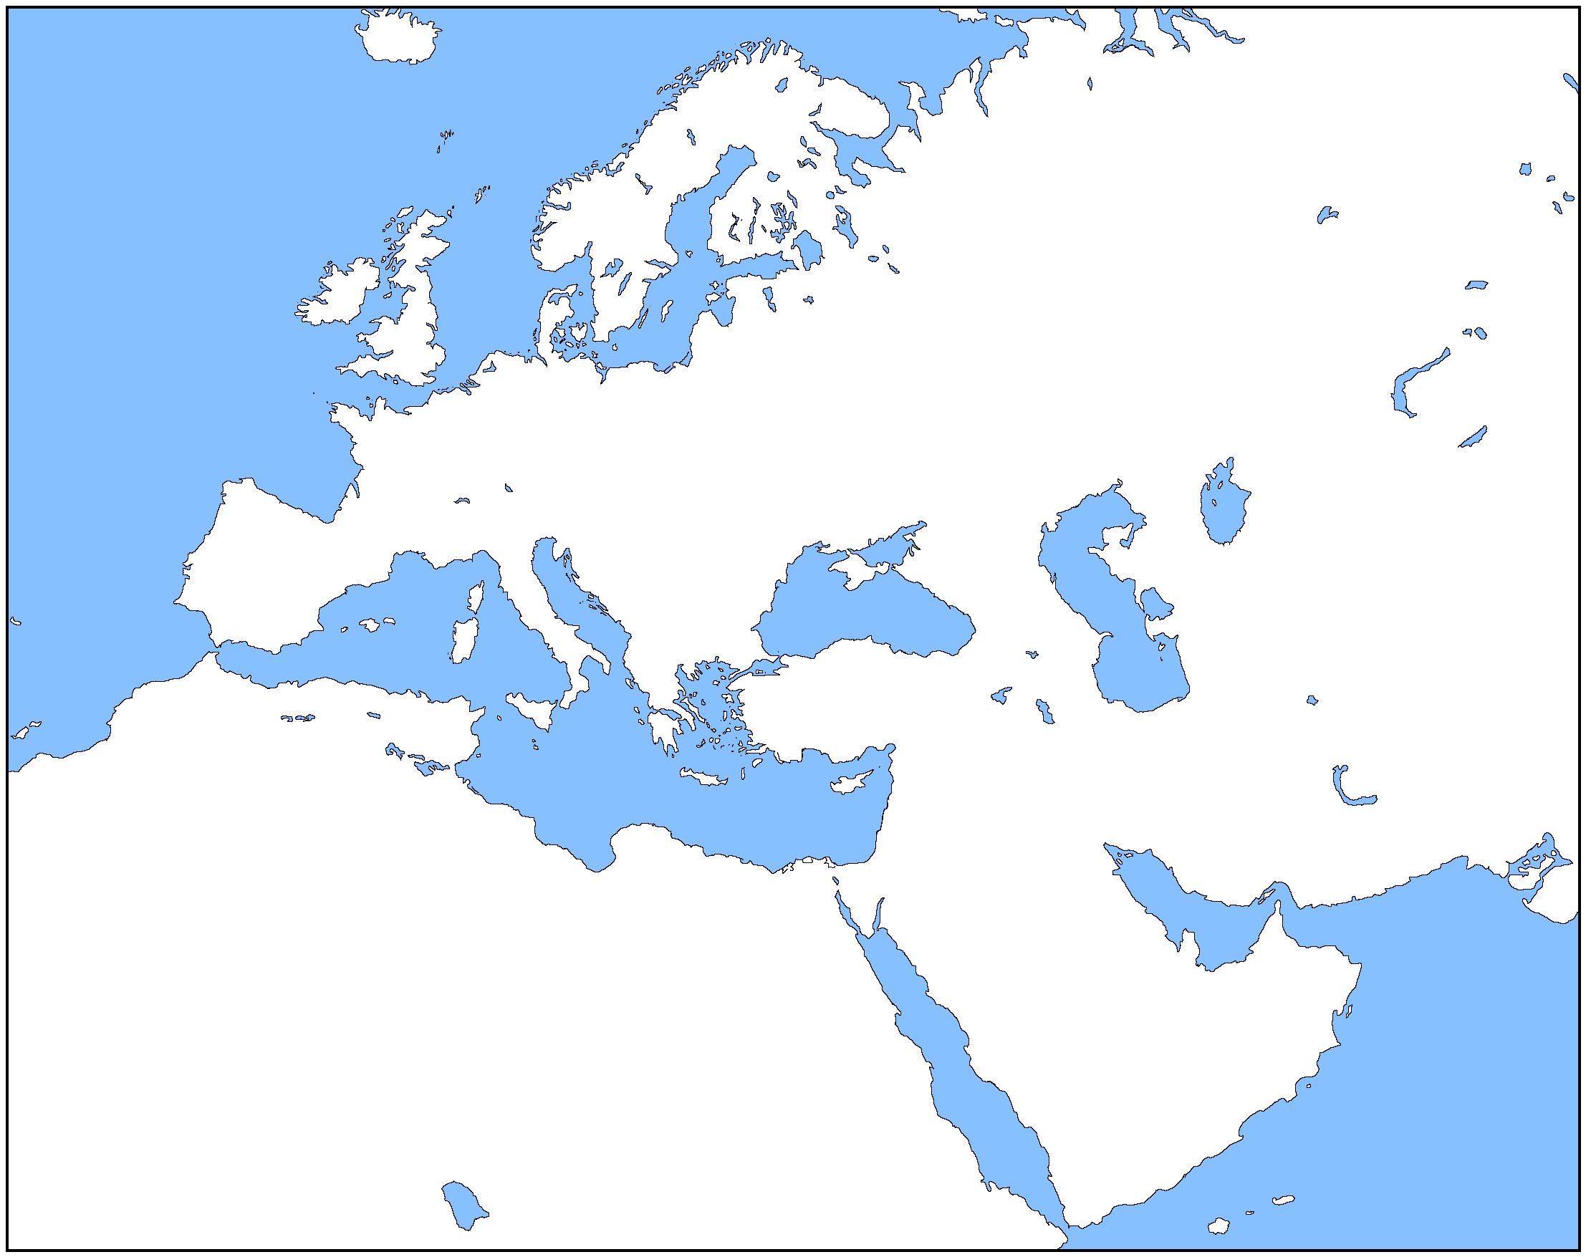
Large scale population movement in the Middle East
EF-like source
3,000 years ago
AFRICA

Slide 35
Conclusion
Balkan theory on the origins of Armenians is rejected
Genetic continuity in the region is not constant across time
There was a large scale population movement across the Middle East after the Bronze Age
As a result of its movement northward, modern Armenians has become genetically altered from their regional ancestors
?
Where the migration is coming from?
What is a trigger of population movement? Climatic changes?

Slide 36
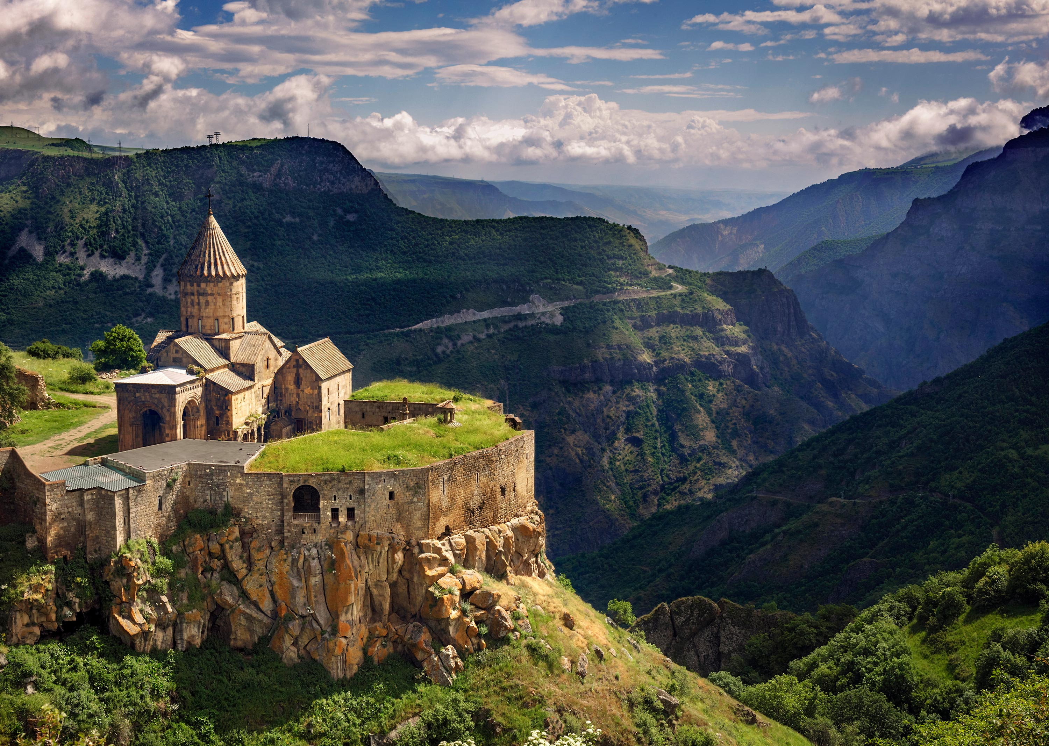
THANK YOU!

